Slide 1
Designing reliable api
RFC 9457 & Proper Status Codes

Slide 2

FAILED SUCCESSFULLY

Slide 3
MEANINGFUL STATUS CODES
status codes communicates class of failure
400: FIX REQUEST
401: AUTHENTICATE
429: BACK OFF (RATE LIMIT)
500: RETRY

Slide 4

MEANINGFUL STATUS CODES
STATUS CODES DO NOT COMMUNICATE DETAILS

Slide 5
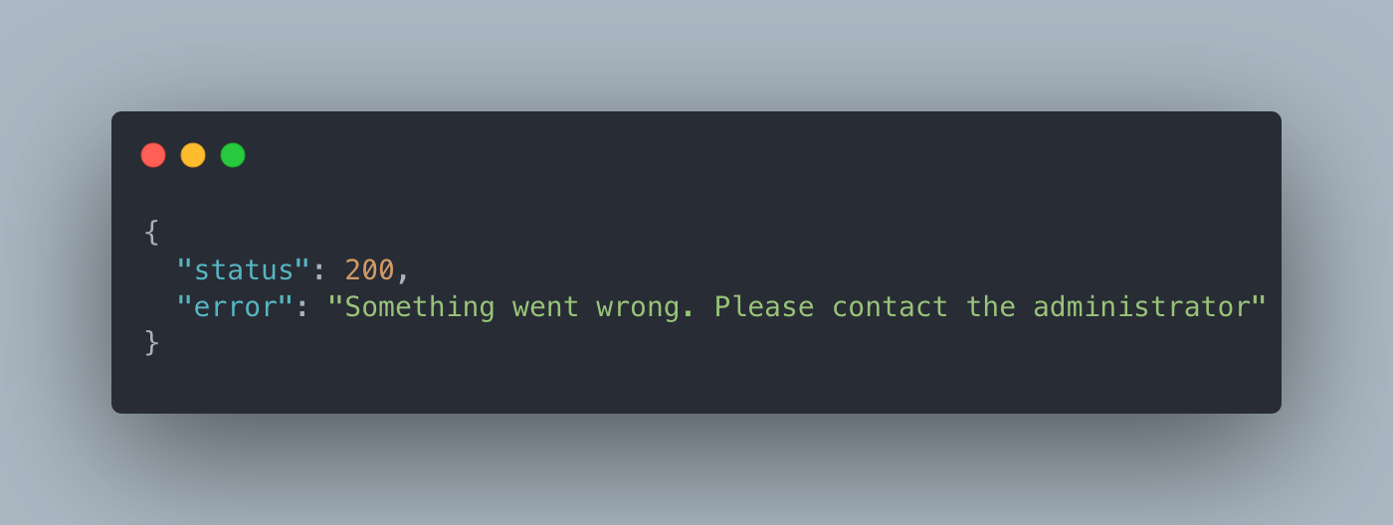
COMMUNICATING DETAILS
PROVIDE CONTEXT TO ALLOW CLIENT TO REACT

Slide 6

COMMUNICATION DETAILS
Server down?
Should Retry?
Was request invalid?
Who’s the admin?

Slide 7

COMMUNICATION DETAILS
No consistency
Hard to parse, log and observe
Hard to build generic tooling

